Slide 1

3-Day Route Trips Around the World
Final Project 2024, Semester B
By: Omri Roter 206502379
Eden Sadon 209136050

Slide 2

Project Overview
1
Purpose
Web app for planning 3-day trips
2
Key Features
Country/trip selection, AI itineraries, interactive maps
3
Technologies
React, Express, Leaflet, Groq API, Stable Horde API

Slide 3
System Architecture
Client-Side
Server-Side
External APIs
React.js components: TripForm, TripInfo, MapComponent
Express.js modules: routeService, groqService, stableHordeService
Groq, Stable Horde, OpenStreetMap

Slide 4
Workflow
1
Step 1
User selects country and trip type
2
Step 2
Server requests itinerary from Groq API
3
Step 3
Server processes LLM response
4
Step 4
Server requests image generation from Stable Horde
5
Step 5
Results displayed with interactive map

Slide 5
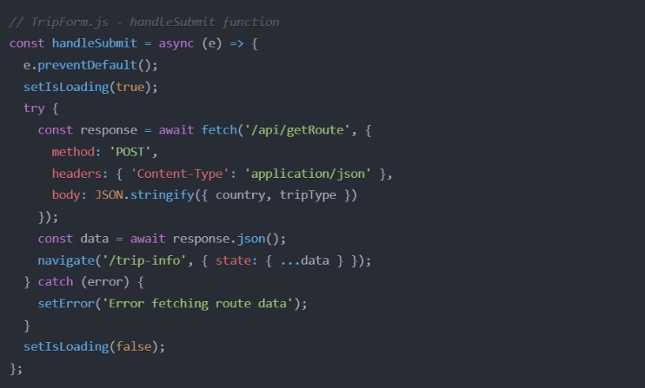
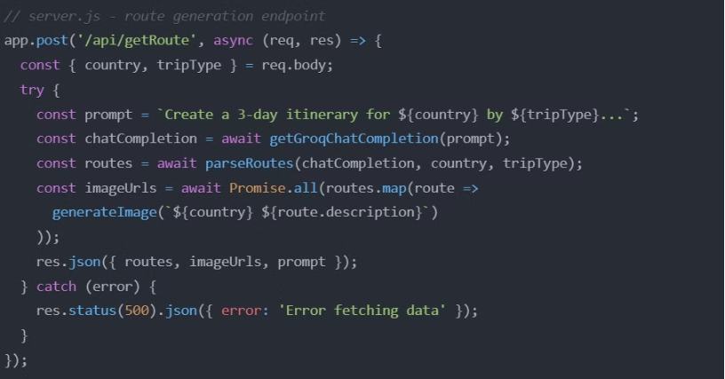
Key Code Snippets
Client-Side (React)
Server-Side (Express)
TripForm.js - handleSubmit function
server.js - route generation endpoint

Slide 6





Technical Challenges
API Integration
LLM Processing
Integrating multiple external APIs
Analyzing responses for accurate itineraries
Route Planning
Response Times
Ensuring continuous, realistic routes within constraints
Handling long Stable Horde API responses

Slide 7

Known Bugs
Issue
Root Cause
Potential Fix
Distance Inaccuracies
LLM estimation
Integrate distance calculation API
Image Generation Failures
Free-tier API limitations
Improve error handling
Geocoding Issues
OpenStreetMap limitations
Implement fallback services

Slide 8

Future Improvements
Enhanced Route Accuracy
Integrate specialized distance and routing APIs
Expanded Trip Options
Add more transportation types and customization
UI/UX Enhancements
Improve responsiveness and interactive elements

Slide 9
Conclusion and Insights
Key Learnings
Achievements
Future Outlook
Prompt engineering importance, integration challenges, AI-user balance
AI-driven trip planner, cutting-edge tech integration, full-stack app
AI in personalized travel, ethical considerations

